Slide 1

CONSUMER PSYCHOLOGICAL AND CULTURAL PROFILE IN PRODUCT MARKETING

Slide 2

Introduction
Marketing is an element that plays a crucial role in the current business environment. The marketing function has devolved across the companies main branch and to all of its branches. This process has yielded positively increasing the profit margins of the company.

Slide 3
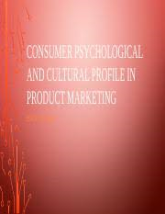
Cultural profile
Cultural beliefs differ from one culture to another. It is the responsibility of the marketing teams to ensure cultural difference doesn’t hinder the use of the product by consumers. The cultural profile can be sub-classified into; cultural types, subculture, social class, communication, and personal level.

Slide 4
Cultural profile
Cultural type
The company has always been obligated to cultural diversity in both domestic and foreign markets. Like the case of the shoe company, customers were treated equally in services provision. Also, the products produced are accepted both in domestic and foreign markets by the customers.
Sub-culture
From the research findings on the sub-cultural beliefs shows that products produced by Shoe Company were both accepted in the domestic and foreign market. These findings, therefore, act as a force by the marketing teams to reach all the customers regardless of there cultural beliefs worldwide.

Slide 5
Cultural profile
Social class
This includes networks, family and status of the customer in both domestic and foreign markets. This was achieved through the quality, standards, design, and branding of the shoe to suit all classes of customers in both markets. As such the rate of shoe buying was highly recommended in both local and foreign markets.
Communication
Shoe Company has personnel who are well conversant with both verbal and nonverbal communication. This was to overcome individual differences among the customers. Due to language differences when it comes to foreign market the company has employed people who can effectively communicate with customers in that case.

Slide 6
Cultural profile
Personal considerations
From the mission of the company that states creating satisfaction to all, the company has been able to consider age, life cycle, occupation, lifestyle, economics and personality of the customers both local and international. These are included to meet the needs of the customers in both the local and international markets.
Psychological profile
The study conducted shows that customer’s perception towards product varies depending on certain factors. Shoes Company Limited provides the following psychological profile on the customers; consumer perception on the product, motivation

Slide 7
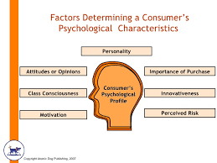
Psychological profile
  Consumer Perception of the product/service
  Motivational factors
  consumers’ needs, wants, desires, and fears
  consumers’ beliefs and values that may influence the purchase

Slide 8
Psychological profile
  Consumer Perception of the product/service
Perceptions of the customers towards goods and services provided by the Shoe Company was the best since the company sold its product at a cheaper price. From the research conducted shows that both local and foreign customers prefer a product from the Shoe Company
Motivation factors
These factors include; brilliant job done, quality of the product, affordable price, availability of the products, customer involvement in the design process, among others. These factors favor both local and foreign make where the product is in accordance with the customer's need.

Slide 9
Psychological profile
  consumers’ needs, wants, desires, and fears
Shoe Company is at the forefront of ensuring consumer’s priority and interest are fulfilled. The research conducted at both local and foreign markets shows that customers want quality products at an affordable price.
consumers’ beliefs and values that influence the purchase
  Customer belief can either positively or negatively affect the company. The belief by the customer on product produce in the shoe company has been a motivational factor that differentiated it from other competitors both locally and internationally. The customers had a belief that the product produced last long and they are first-class products.

Slide 10
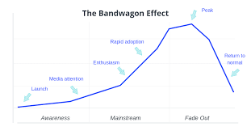
Graphic showing marketing psychology

Slide 11
References
Crookall, P. and H. Schachter (2004) Changing Management Culture Report (2004), Canada: Treasury Board of Canada Secretariat, http://www.tbssct.gc.ca/cmo_mfc/resources2/research/rr00_e.asp
Denison, D.R. (1990), corporate culture and organizational effectiveness. New York: Wiley.
Hatch, M.J. (1997) Organization Theory: Modern, Symbolic and Postmodern Perspectives. New York: Oxford University Press.

